Slide 1

Part 3
Chapter 11
Matrix Inverse and Condition
PowerPoints organized by Dr. Michael R. Gustafson II, Duke University
All images copyright © The McGraw-Hill Companies, Inc. Permission required for reproduction or display.

Slide 2
Chapter Objectives
Knowing how to determine the matrix inverse in an efficient manner based on LU factorization.
Understanding how the matrix inverse can be used to assess stimulus-response characteristics of engineering systems.
Understanding the meaning of matrix and vector norms and how they are computed.
Knowing how to use norms to compute the matrix condition number.
Understanding how the magnitude of the condition number can be used to estimate the precision of solutions of linear algebraic equations.

Slide 3
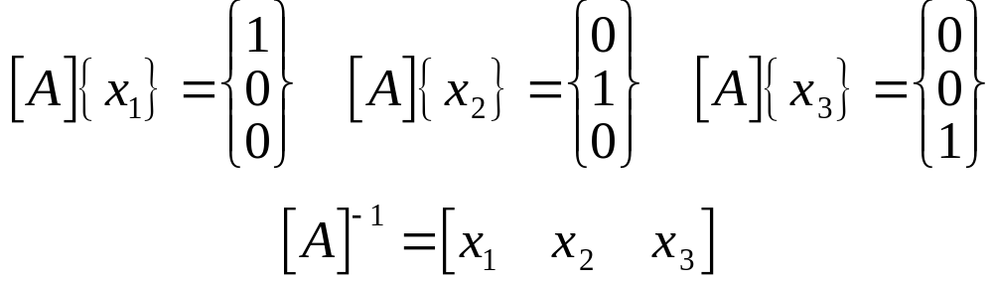
Matrix Inverse
Recall that if a matrix [A] is square, there is another matrix [A]⁻¹, called the inverse of [A], for which [A][A]⁻¹=[A]⁻¹[A]=[I]
The inverse can be computed in a column by column fashion by generating solutions with unit vectors as the right-hand-side constants:

Slide 4
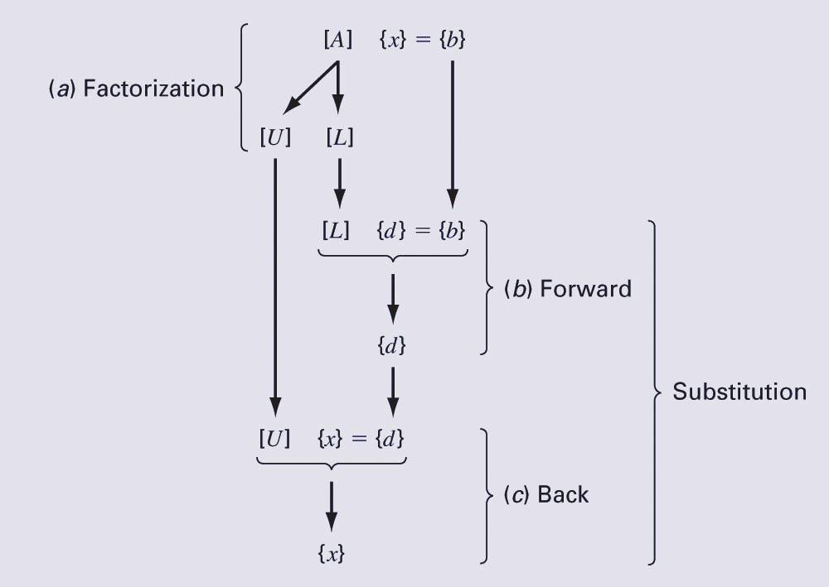
Matrix Inverse (cont)
Recall that LU factorization can be used to efficiently evaluate a system for multiple right-hand-side vectors - thus, it is ideal for evaluating the multiple unit vectors needed to compute the inverse.

Slide 5
Stimulus-Response Computations
Many systems can be modeled as a linear combination of equations, and thus written as a matrix equation:
The system response can thus be found using the matrix inverse.

Slide 6
Vector and Matrix Norms
A norm is a real-valued function that provides a measure of the size or “length” of multi-component mathematical entities such as vectors and matrices.
Vector norms and matrix norms may be computed differently.

Slide 7
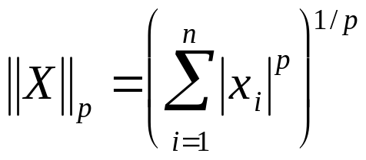
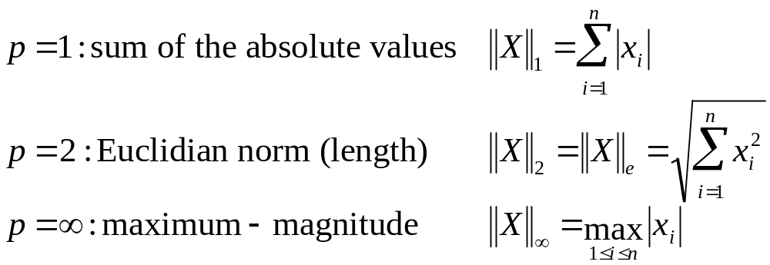
Vector Norms
For a vector {X} of size n, the p-norm is:
Important examples of vector p-norms include:

Slide 8
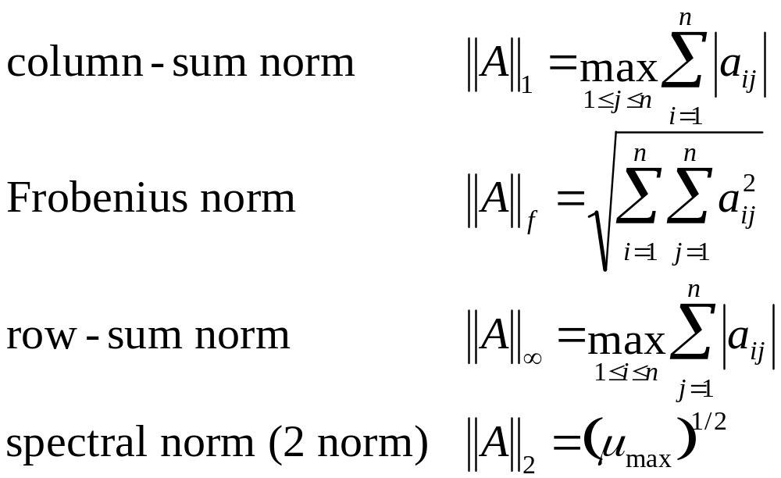
Matrix Norms
Common matrix norms for a matrix [A] include:
Note - μ_{max} is the largest eigenvalue of [A]^{T}[A].

Slide 9
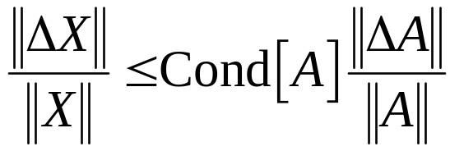
Matrix Condition Number
The matrix condition number Cond[A] is obtained by calculating Cond[A]=||A||·||A⁻¹||
In can be shown that:
The relative error of the norm of the computed solution can be as large as the relative error of the norm of the coefficients of [A] multiplied by the condition number.
If the coefficients of [A] are known to t digit precision, the solution [X] may be valid to only
t-log₁₀(Cond[A]) digits.

Slide 10
MATLAB Commands
MATLAB has built-in functions to compute both norms and condition numbers:
  norm(X,p)
    Compute the p norm of vector X, where p can be any number, inf, or ‘fro’ (for the Euclidean norm)
  norm(A,p)
    Compute a norm of matrix A, where p can be 1, 2, inf, or ‘fro’ (for the Frobenius norm)
  cond(X,p) or cond(A,p)
    Calculate the condition number of vector X or matrix A using the norm specified by p.

